Slide 1

AUDIOVIBE

Slide 2
AudioVibe
AudioVibe is a platform offering a vast catalogue of music accessed by users across various countries.
Key Functionalities:
1)The user has the ability to add(while signing up for the platform), update(change his password) and delete his personal information.
2)The user can create playlists, add/delete songs from the playlist and also depending on his subscription skip advertisements.
3)Provides a seamless experience with robust identity management, secure transaction processing, and intuitive playlist management for user personalization.

Slide 3
Data Sources and Tools
Data Sources:
KaggleDataset-https://www.kaggle.com/code/tayyarhussain/tiktok-songs-2020-dataset-data-analysis
Manual generation of Data
Tools-
MySQL WorkBench
Java
Python
Spring boot
Postman
Team and Roles
Niraj Chaudhari Database Design, DB-Backend Integration
Naveen Subhash U Database Design, SQL Queries, Data Analysis
Nitika Jain Database Design, SQL Queries, Data preprocessing

Slide 4
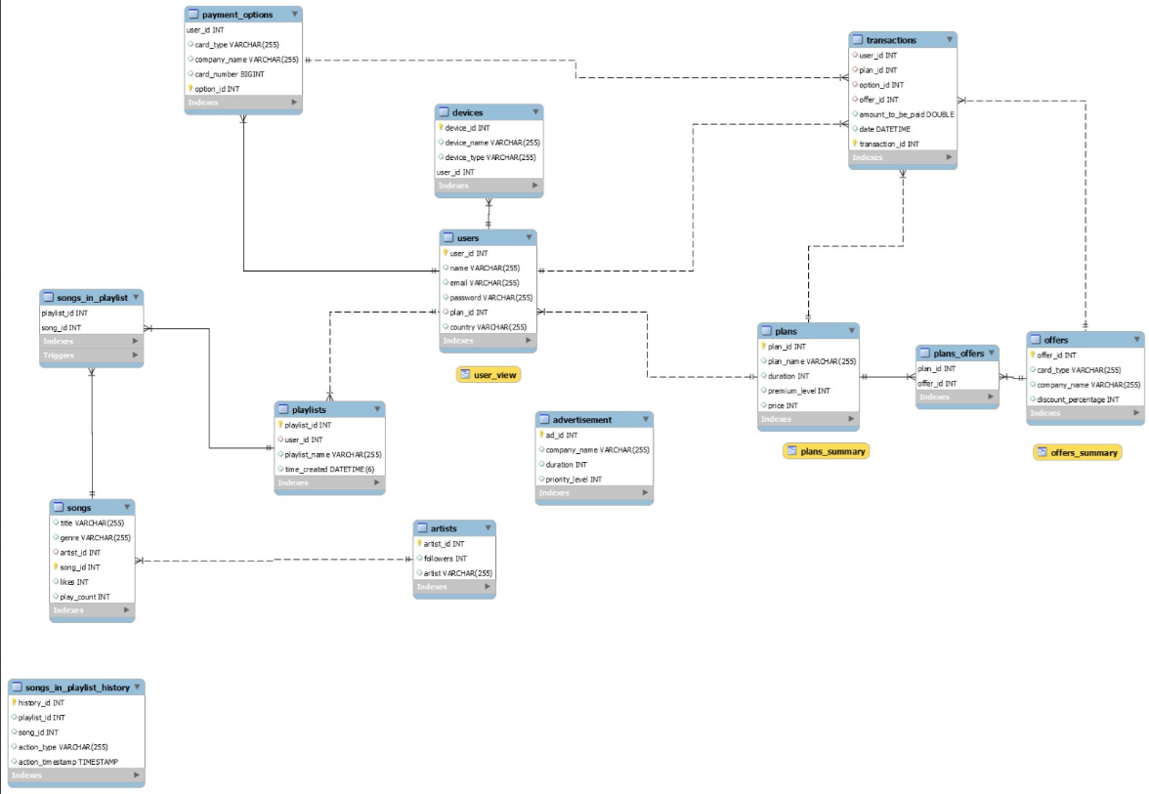
ERD

Slide 5
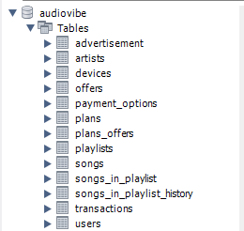
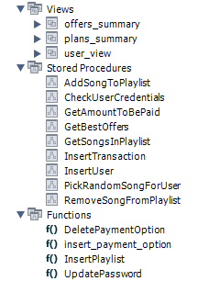
Tabular View

Slide 6
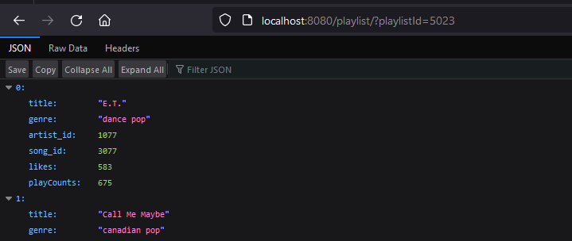
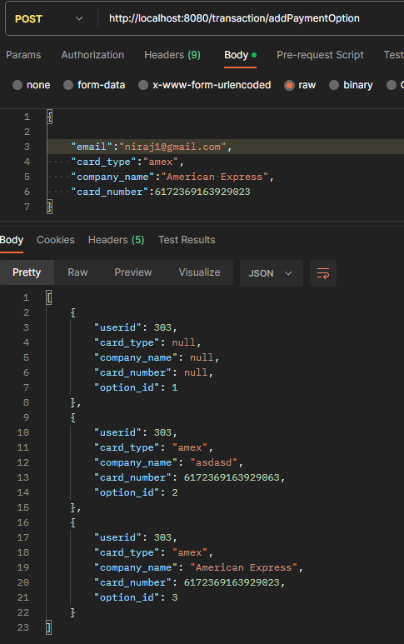
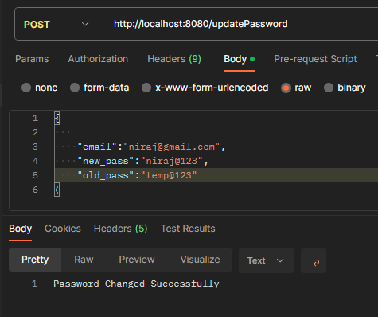
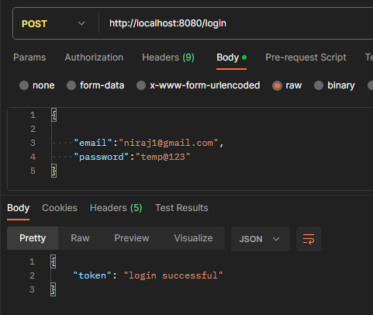
DEMO

Slide 7
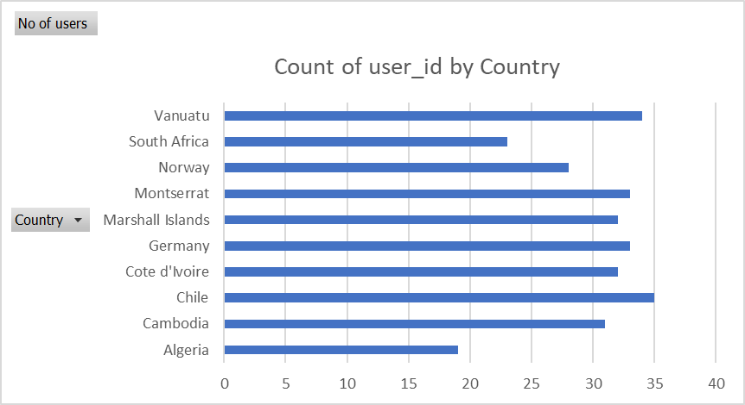
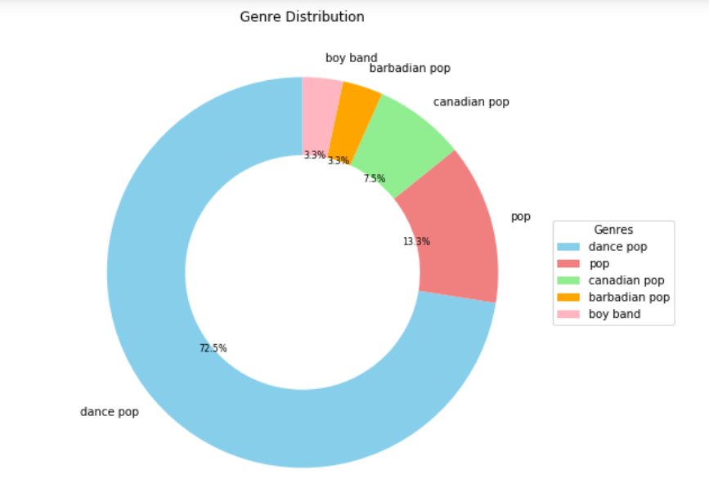
Graphs
The below graph shows the genre distribution based on the number of likes from users.
From the above graph, we see the no of users for each country in our DB.
Chile and Vanuatu have the most users who are using this platform.
The insights from the above graphs, can help us with recommendation algorithms that would lead us to recommend songs from the most liked genre.
We can also focus on user engagement strategies on countries with low user count such as Algeria.

Slide 8
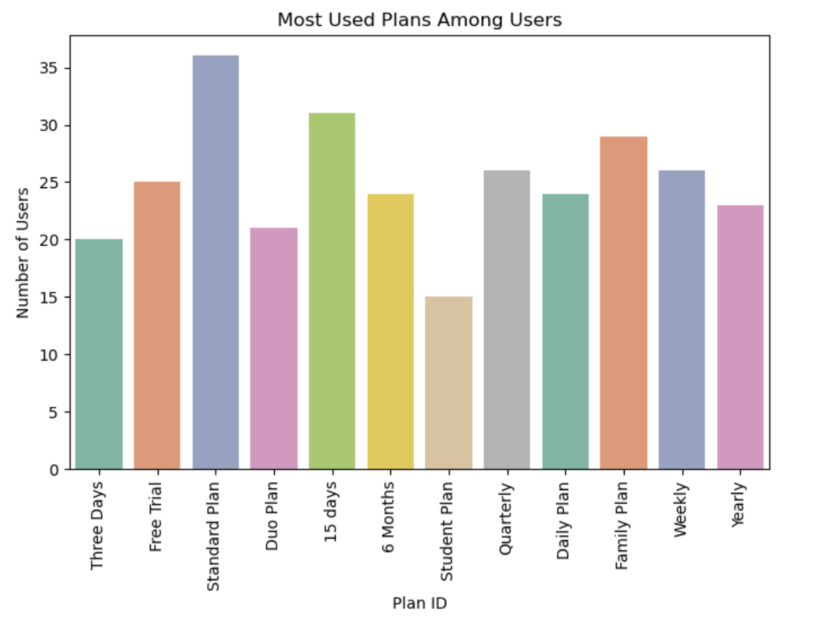
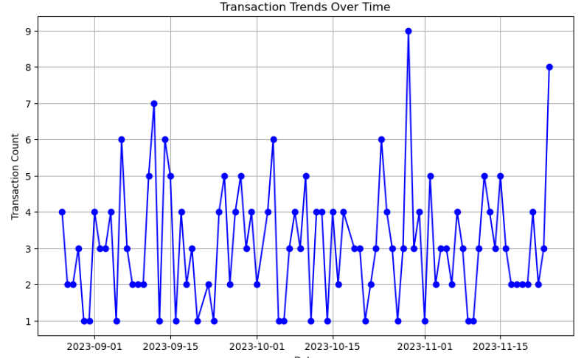
Targeted incentives or additional benefits could be developed for more popular plans to maintain the high subscription rate for these plans.
Review marketing strategies for less-used plans to evaluate the user needs or expectations.
More subscriptions at certain time indicate holiday seasons or promotional campaigns.
Increasing more offers or discounts at those seasons can increase the customers.

Slide 9
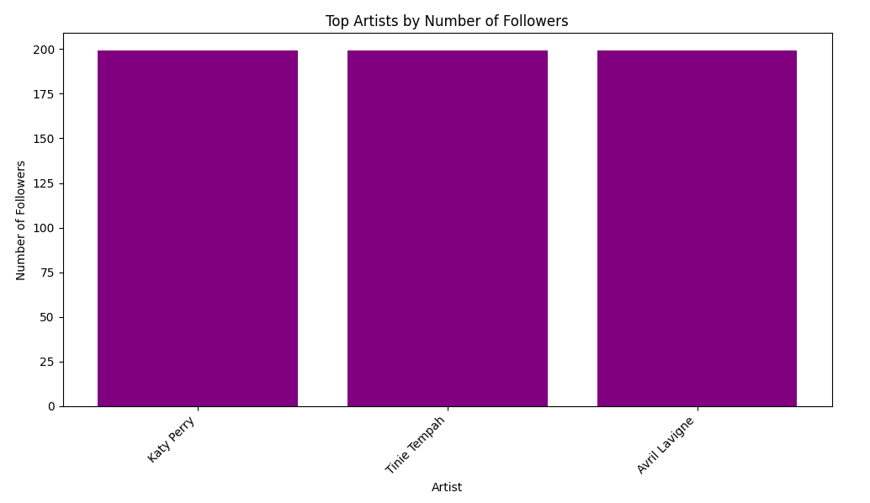
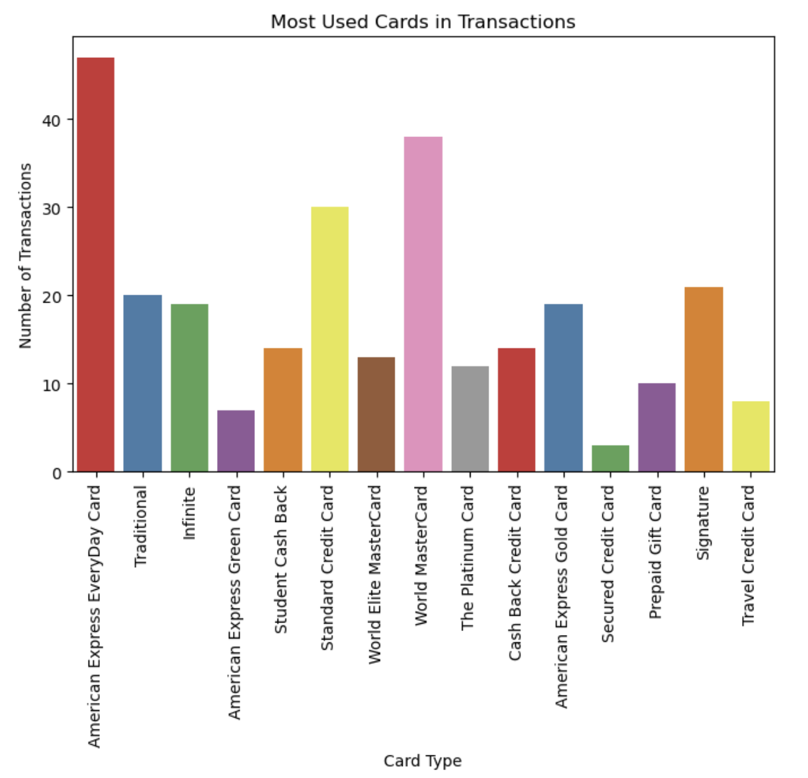
We observe from the artists table, the 3 most followed artists as represented in the graph.
Based on this we can recommend more songs from these artists to the users.
Strategic Partnerships with businesses, where the certain card usage is high, to offer exclusive deals, or rewards.
Student Cash Back card is having less customer base. Incorporating strategies to increase discount on this card would gain more customers.

Slide 10
THANK YOU!

